Slide 1
This PowerPoint covers the essays in the 2018 Conference Agenda Report
FIPT
The SF Regional Request
Illicit Literature
The Future of the WSC
NAWS Strategic Plan
CAR Survey

Slide 2
Fellowship Intellectual Property Trust
Notes:
We’ll start by offering some background on the Fellowship Intellectual Property Trust drawn from an essay in the 2018 CAR and related to motions 7 and 8, which we’ll also discuss here.

Slide 3
What’s a FIPT?
The Fellowship Intellectual Property Trust (FIPT) represents the collective decisions of the World Service Conference (WSC) to preserve
the integrity of NA’s published message, and
the accountability of our publishing services
Notes:
The Fellowship Intellectual Property Trust—or FIPT—represents the collective decisions of the World Service Conference to preserve the integrity of NA’s published message and the accountability of its publishing services. It provides the foundation for our stewardship of the NA message around the world.

Slide 4
Background
Controversy about the production and distribution of the Basic Text led to a lawsuit
A difficult time for all
Hope was that Conference decisions would give the Fellowship common ground from which to move forward
Notes:
The FIPT came about as a result of a lawsuit prior to 1991 concerning the production and distribution of the Basic Text. It was a difficult time for all involved. The hope was that the Conference decisions would give the Fellowship common ground from which to move forward.

Slide 5
WSC 1991: Discussion and Decision
The WSC provided clear direction on the production and sale of NA literature when it passed this motion:
To reaffirm and ratify that the ownership of all of N.A.'s intellectual and physical properties prepared in the past, and to be prepared into the future, is held by WSO, Inc., which holds such title in trust on behalf of the fellowship of Narcotics Anonymous as a whole, in accordance with the decisions of the World Service Conference.
Notes:
The WSC took time to discuss many options and get additional clarity about intellectual property law including a question and answer session with the WSO’s intellectual property attorney.
Ultimately, the 1991 Conference was able to provide clear direction when it passed this motion:
To reaffirm and ratify that the ownership of all of N.A.'s intellectual and physical properties prepared in the past, and to be prepared into the future, is held by WSO, Inc., which holds such title in trust on behalf of the fellowship of Narcotics Anonymous as a whole, in accordance with the decisions of the World Service Conference.
This identified the WSO as the single management point for the production and distribution of NA’s conference-approved written message.

Slide 6
WSC 1991: Clarifying Group Conscience
In response to illicit literature and the resulting lawsuit, delegates issued the following statement to the Fellowship:
The Basic Text, Fifth Edition* is the only edition of the Basic Text that is currently approved by the World Service Conference of Narcotics Anonymous for publication and sale. The World Service Office Board of Directors is entrusted with the responsibility for protecting the fellowship's physical and intellectual properties, including the Basic Text, and at the board of directors’ discretion, shall take legal action to protect those rights against any and all persons who choose to infringe upon this literature trust.
*the Sixth Edition replaced the Fifth in 2008
Notes:
After much discussion and consideration of several motions, Conference participants also voted to issue this statement to the Fellowship, in response to the struggles over illicit literature that had culminated in the lawsuit:
“The Basic Text, Fifth Edition, is the only edition of the Basic Text that is currently approved by the World Service Conference of Narcotics Anonymous for publication and sale. The World Service Office Board of Directors is entrusted with the responsibility for protecting the fellowship's physical and intellectual properties, including the Basic Text, and at the board of directors’ discretion, shall take legal action to protect those rights against any and all persons who choose to infringe upon this literature trust.”

Slide 7
1991-1993: The FIPT was developed by Board of Trustees, WSO Board, and an RSR Working Group
The sole object and purpose of this Trust is to hold and administer all recovery literature and other intellectual properties of the Fellowship of Narcotics Anonymous in a manner that will help addicts find recovery from the disease of addiction and carry that message of recovery to the addict who still suffers, in keeping with the Twelve Steps and Twelve Traditions of NA.
FIPT, Article 1, Section 4
Provides foundation for stewardship of the NA message
Ensures fidelity of our message
Support for Fellowship development including translations, PR, and other core services
Notes:
In the two-year cycle following WSC 1991, the Board of Trustees worked with the WSO Board, and a regional service representatives (now called regional delegates) working group to develop the Fellowship Intellectual Property Trust. This would provide the legal foundation for the stewardship of NA literature and the NA message around the world. As stated in Article 1, section 4 of the FIPT:
The sole object and purpose of this Trust is to hold and administer all recovery literature and other intellectual properties of the Fellowship of Narcotics Anonymous in a manner that will help addicts find recovery from the disease of addiction and carry that message of recovery to the addict who still suffers, in keeping with the Twelve Steps and Twelve Traditions of NA.
By approving the FIPT, the Conference assigned the World Service Office with the task of protecting our intellectual property on behalf of the Fellowship. Funds generated by literature sales further our primary purpose. This plays out time and again around the world as newer NA communities benefit from NAWS’ guidance and support for translations, as an example. This ensures the fidelity of the NA message in every language and funds the important work of Fellowship development, public relations, translations, and other core services

Slide 8
Illicit Literature
Challenges continue to appear from time to time
Renewed efforts to distribute illicit literature—a 1980s-style hybrid combining different editions of the BT
NA communities have been key to rejecting this latest wave of unethical behavior
Recognized that it does not reflect group conscience
Notes:
Despite the best efforts of the 1991 and 1993 Conferences to put these matters to rest, challenges continue to appear from time to time. Most recently, we’ve seen campaigns to publish illicit literature like that of an earlier era. As we were happy to report last year, these efforts seem to have faded as NA communities have become better informed.
NA communities have rallied to reject this latest wave of unethical behavior of those involved and the publications they produce. The once-steady stream of inquiries about the illicit publication and its distribution attests to “the integrity and effectiveness of our communications” as discussed in Concept Eight and the strength of local efforts to get the word out that illicit literature does not reflect group conscience.

Slide 9
FIPT Inspection Request
Notes:
This concludes information on FIPT-related motions, but before leaving this topic, we’ll offer information on an FIPT inspection request from the South Florida Region and summarize some frequently asked questions that are also included in the CAR. Here’s a thumbnail sketch of the background on this request and a snapshot of the current status, but we encourage members to read the complete Fellowship Intellectual Property Trust essay in the CAR.

Slide 10
Background and Current Status
The South Florida region passed a motion to “agree in principle…[to] request an inspection of the records and operations of NA World Services per the Fellowship Intellectual Property Trust (FIPT)…”
NAWS received a request detailing 10 concerns, some of which seem unrelated to the FIPT
This being a legal matter, the Board consulted with attorneys
Requested clarification from the region on a number of items
Awaiting a response from the region
Notes:
In December 2016, the South Florida Region passed a motion to “…agree I principle…[to] request an inspection of the records and operations of NA World Services per the Fellowship Intellectual Property Trust (FIPT)…” The day after our April 2017 Board meeting, NAWS received a request from the South Florida Region detailing 10 concerns, some which seem unrelated to the FIPT. This being a legal matter, the Board consulted with attorneys and discussed it at length at our July meeting.
This was a request to invoke a legal inspection as called for in the trust document. We needed to understand clearly what we were being asked and we quickly realized we needed some clarification from the region following our July meeting. We’re currently awaiting a response from the region to our request for clarification that was sent in August.
Following are some frequently asked questions about the FIPT and this request, which are available in their complete form in the CAR.

Slide 11
FIPT Inspection Request Frequently Asked Questions (FAQ)
Q: Doesn’t the FIPT say that any region can request an inspection?
A: Yes, but the request, as submitted, may not conform to the guidelines laid out in the FIPT.
The region agreed in principle that an inspection request be drafted
It’s unclear if the region had the opportunity to review or approve the request that was submitted
We have requested clarification from the region.
Notes:
QUESTION: Doesn’t the FIPT say that any region can request an inspection?
ANSWER: Yes, but the request, as submitted, may not conform to the guidelines laid out in the FIPT. To begin with, the motion passed by the requesting region appears only to have authorized that they agreed in principle that an inspection request be drafted. To date, we have not been able to confirm that the region had the opportunity to review or approve the specific request that was submitted on their behalf. We have requested clarification from the region.

Slide 12
FIPT Inspection Request Frequently Asked Questions (FAQ)
Q: Why did NAWS consult an attorney?
A: ⦁ The FIPT is a legal document
The request from the region relates directly to this document
It seems prudent to consult legal counsel on legal matters
Notes:
QUESTION: Why did NAWS consult an attorney?
ANSWER: The FIPT is a legal document filed in the state of California. The request from the region relates directly to this document, so it seemed prudent to consult legal counsel. This is new territory for us. No region has ever called for an inspection, so there’s no experience to draw on for enacting this provision.

Slide 13
FIPT Inspection Request Frequently Asked Questions (FAQ)
Q: Why the delay? Is NAWS stonewalling?
A: ⦁ Incorrect comparison: “like asking your home group’s treasurer to see the group’s records and being refused.”
More apt comparison: “like asking the treasurer to spend money and being asked to wait until the group can be consulted.”
We aren’t stonewalling; we’re simply trying to be responsible stewards of the Fellowship’s resources.
Notes:
QUESTION: Why the delay? Is NAWS stonewalling?
ANSWER: Some people have incorrectly compared the inspection request and the time we’re taking to fulfill that request to asking your home group’s treasurer to see the group’s records and being refused. We can see how this comparison could cause alarm. Others have noted that a more apt comparison would be a scenario in which a group member asks the treasurer to spend money and and is told by the treasuere that s/he would need to consult with the rest of the group. We aren’t stonewalling; we’re simply trying to be responsible stewards of the Fellowship’s resources.
Put simply, it just takes time to work through all that’s involved with this request. Getting clarification from the region is our first order of business. It’s not clear that they intended to initiate this large of a project—the estimated fees from our CPA are $100,000 for their involvement alone—so we felt obliged to inform the region about the level of time and effort involved in the enterprise, as proposed, and the expense this labor would generate. It also seemed to us that the WSC would want a chance to discuss the matter, given the level of investment this request would require.

Slide 14
FIPT Inspection Request Frequently Asked Questions (FAQ)
Q: Why don’t you just give them what gets handed to the auditors?
A: ⦁ A reputable CPA firm performs an annual audit of NAWS’ finances
Audit is an annual investment of $20,000 to $30,000
Results reviewed by audit committee, presented to World Board, published in NAWS Annual Report (www.na.org/ar)
Conforms to accounting industry standards
Doesn’t seem like the request is simply to duplicate this process
Notes:
QUESTION: Why don’t you just give them what gets handed to the auditors?
ANSWER: We hire a reputable independent CPA firm to perform an annual audit of NAWS’ finances. Their team spends weeks in the Chatsworth office each spring reviewing a myriad of randomly selected documents and ledgers, independently contacting each of the banks we use, and comparing our practices and records to published policies and established accounting practices. This annual audit costs us between $20,000 and $30,000, and the results are reviewed by an audit committee, presented to the Board, and published in each Annual Report. This process conforms to accounting industry standards and has not been called into question previously by the WSC. Annual Reports that include the independent auditor’s report dating back to 2003 are posted online at www.na.org/ar. Again, we’re still awaiting clarification from the region, but it doesn’t seem like the request is simply to duplicate this process

Slide 15
FIPT Inspection Request Frequently Asked Questions (FAQ)
Q: Why wait for the WSC to resolve this?
A: ⦁ Given the resources required, we want to give the WSC an opportunity to address this matter
It’s worth taking the time to resolve this thoughtfully
Regional delegates have every right to raise legitimate concerns about trust-related activities
We want to be sure an inspection addresses the needs of NA as a whole
If the Conference shares the requesting region’s concerns, we would immediately comply with a request
Notes:
QUESTION: Why wait for the WSC to resolve this?
ANSWER: Given the investment of Fellowship funds required—even if the request were to be scaled back—we feel compelled to consult with the Conference and give the WSC an opportunity to address this matter. NAWS is moving forward with all deliberate speed while maintaining our commitment to integrity and accountability. It’s an important matter, and it’s worth taking the time to resolve this thoughtfully.
Regional delegates have every right to raise legitimate concerns about trust-related activities. When and if an inspection is performed, we want to be sure it addresses the needs of NA as a whole. If the Conference shares the requesting region’s concerns, we would immediately comply with a request.

Slide 16
FIPT Inspection Request Frequently Asked Questions (FAQ)
Q: What’s this talk about changing the FIPT as a result of this request?
A: ⦁ Inspection provision hasn’t been updated since WSC approved the FIPT in 1993
Since then, World Services was restructured, creating NAWS:
Single, unified budget for WSO, WSC, and WCNA
WSC review/approval of all operating expenses (not just WSC)
One single Board elected by and accountable to the WSC
Good for accountability, but FIPT-related income and expenses are not tracked separately.
Resources required to fulfill a request like this are significant, so want to consult the WSC
Notes:
QUESTION: What’s this talk about changing the FIPT as a result of this request?
ANSWER: The inspection provision in the FIPT has not been updated since the document was approved by the WSC in 1993. We were a much smaller Fellowship at that time, and our services and budgets were organized differently in those days. As part of a comprehensive review, World Services was restructured, and a single, unified budget replaced separate budgets for the Office, Conference, & Convention. This took place years after the FIPT was approved. Prior to the restructuring, the office and convention budgets were not reviewed and approved by the Conference. Since restructuring, the Conference reviews and approves all our operating expenses in a unified budget. As a result of this restructuring, one Board—the World Board of NA—would be elected by and accountable to the World Service Conference.
And while all of that makes sense in terms of accountability, it does complicate matters in terms of a FIPT inspection. Income and expenses associated with the intellectual property held in trust are not tracked separately; they’re now mixed with other revenue streams at World Services, and none of our expenses are categorized as FIPT or non-FIPT expenses. Separating out trust-related funds from current ledgers would be no small task.
The resources that would be required to fulfill the request, as written, set off some alarm bells. We were not comfortable devoting that much time and money without consulting the WSC. The idea that a single region can initiate an inspection process, without regard to its cost, seems more aligned with the WSC of the early 1990s than with the collaborative, consensus-based body we have today. Given the nature of our Conference today, we feel obliged to give the WSC an opportunity to discuss the possibility of amending the FIPT in the future.

Slide 17
The Future of the WSC

Slide 18

Future of the WSC
The Future of the WSC is an ongoing project about improving the effectiveness and sustainability of the Conference.
Reports and related material are posted at www.na.org/future
Project is focused on:
a) WSC seating
b) the WSC week itself
c) better use of the time between Conferences
Seating is where we are challenged to reach consensus and the Board has stepped back from framing seating options for discussion
Notes:
The Future of the WSC is an ongoing project about improving the effectiveness and sustainability of the Conference. The project stems from an objective in the 2016–2018 NAWS Strategic Plan. We have issued three reports about these ideas and held several Conference participant web meetings. These reports and other related materials can be found online at www.na.org/future.
The Future of the WSC project has three main strategies to improve the sustainability and effectiveness of the WSC: discussing options for seating; improving the effectiveness of the WSC meeting itself; and making better use of the time between Conferences. Seating is the most challenging part of this work and we have stepped back from trying to frame seating options for the Conference to discuss.
The primary focus of the CAR essay is on the recommendations to improve the Conference week itself. More about these suggestions can be found in the first and third Future of the WSC reports.

Slide 19
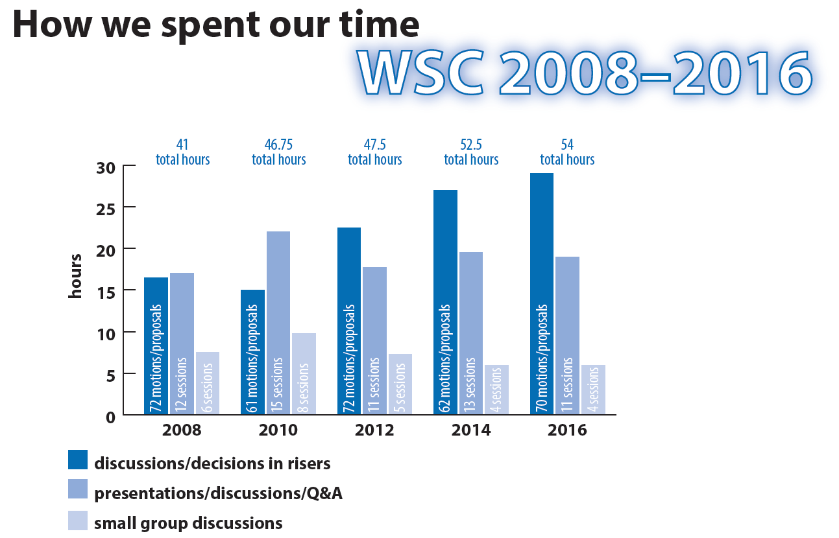
Notes:
As this diagram from the CAR shows, the last five Conferences have each been longer than the one before. More time is spent discussing and deciding on motions and proposals, and less on presenting information and discussing ideas in small groups.

Slide 20
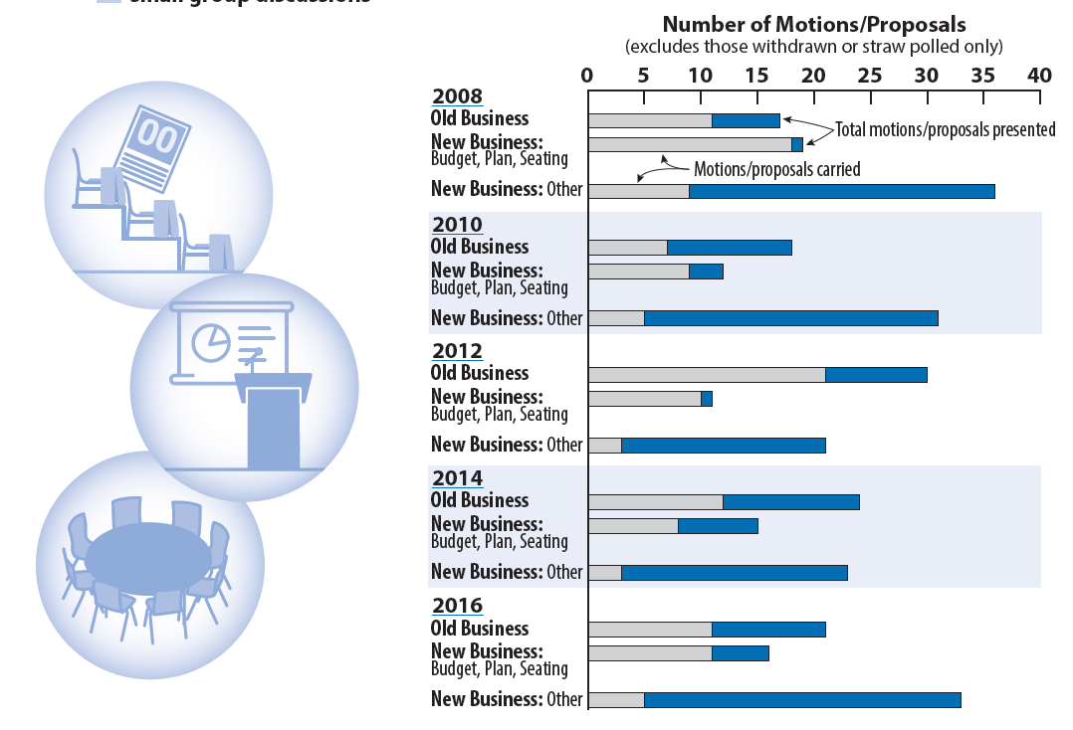
Notes:
This graph gives you some idea of how effective that extra time spent on motions and proposals has been. The motions and proposals considered in each business session over the last five Conferences have been represented on these bar graphs. The grey sections represent how many of those motions passed. If you look at the bottom bar for each Conference, you’ll see that it’s clear that many new business proposals are submitted but very few are passed.

Slide 21
Time available at WSC
24, 90-minute sessions over 6½ days + evening sessions
14 sessions cover essential topics
Welcoming, orientation, and community-building (3)
Human Resource Panel and elections (2)
NAWS and World Board reports + Q&A (3)
Budget and project plans—presentation and approval (2)
Fellowship Development and PR (2)
Moving Forward and Closing (2)
Plus time for CAR-related discussion & decisions
13½ hours spent in 2014 & 18 hours in 2016
Notes:
The CAR provides a detailed breakdown of the available hours at a Conference and the essential topics that are covered each year. Taking into account the time needed for necessary breaks, the Conference has time for 24 sessions lasting 90 minutes each. This slide lists fourteen of the sessions we feel are essential that are described briefly in the CAR.
Additional time is also needed to discuss and reach decisions on the issues contained in the CAR. Thirteen and half hours was spent on this in 2014, and eighteen hours in 2016, leading to the cancellation and combining of several planned sessions. Making careful decisions in a body as large as the Conference takes time, but the amount of time we are spending does not seem productive.

Slide 22
Recommendations for 2018
Remove formal business session
All decisions would be made during the discussion session currently held prior to the formal session
Old business would now be “CAR-related discussions and decisions”
CAR motions + proposals to amend those motions
Approval of minutes
Motions/proposals about business processes
Divide new business into two sessions
Discussion and decision of CAT-related motions and proposals (budget, project plans, seating regions, and other CAT issues)
New proposals submitted at the WSC
Notes:
Since 2004 we have been scheduling a discussion session prior to the formal decision-making sessions at the Conference. We believe there is consensus to eliminate the formal business sessions of the WSC entirely and make all of the CAR- and CAT-related decisions in the discussion sessions.
What was previously called “old business” would now be CAR-related discussions and decisions.
What we have been calling “new business” would now be divided into two different types of sessions. One session would focus on CAT-related discussion and decisions, which would include motions or proposals to approve the budget and project plans, seat regions, and address any other decision items forwarded by the Board in the Conference Approval Track material. The second type of session is for proposals newly submitted at the WSC.

Slide 23
Recommendations for 2018
Revise process for new proposals
Ideas and proposals can be shared before the Conference, but most new business is not
New proposals will be prioritized by Conference participants
Address only the number of proposals that can be addressed in the time allotted
Process for other proposals that attract more than 50% support but no time is available to discuss will be determined by the Conference
Wrap-up discussions will take place on Saturday morning
Notes:
The most exciting changes we are suggesting have to do with the proposals submitted at the WSC. There are a number of ways for participants to share ideas or proposals prior to the Conference, but most of the proposals submitted as part of new business haven’t been shared with other participants before the WSC. As the graphs we just looked at show, many proposals are submitted but very few are passed. In addition to this, the length of time spent on new business at the last two Conferences meant we had to reschedule the last day’s sessions. These sessions are crucial to making sure we all end the Conference with a shared understanding, and were greatly undermined.
Our suggestion is for participants to prioritize all new proposals and then discuss only the most highly rated in small-group breakout sessions. Two 90-minute sessions will be scheduled for these discussions. If there are any proposals that more than half of participants want to discuss that we do not have time to get to, we can make a collective decision, as a Conference, about how to carry those ideas or concerns forward after the WSC. The Moving Forward session on Saturday morning will be an opportunity to report back to the large group and cement a shared understanding of the breakout room discussions.

Slide 24
Recommendations for 2018
Change the voting threshold to 2/3 for everything
Procedural arguments at WSC 2016 about voting threshold required for different motions
Reflects the evolution towards consensus-based decision making
Percentages for elections remain unchanged
60% for World Board
50% for WSC Cofacilitators and Human Resource Panel members
Notes:
One of the procedural issues we argued about the most at the last WSC was whether a given decision required a two-thirds majority or a simple majority. We are suggesting making a change to Conference processes and requiring a two-thirds majority for all decisions except elections, which will require the same percentages they do now. A higher threshold for decision making seems to be in concert with our evolution, as a Conference, in the direction of consensus-based decision making. We have recently made this same change for decisions made by the World Board.

Slide 25
Recommendations for 2018
Improving the use of time between Conferences
Forum for discussion and development of ideas is needed, but unclear what medium to use for this
Current options are underutilized
Difficult to maintain focus and follow through over the course of many months
Web meetings have helped and may be used to carry forward discussions begun at WSC 2018
Notes:
The Future of the WSC project also focused on ways to improve the use of time between Conferences. Communication continues to be a challenge for us as a Conference and we still struggle with how to develop ideas together throughout the cycle.
The current forums for sharing and developing ideas—the Conference participant discussion board and the FTP site—are both underutilized, and it continues to be a challenge to maintain focus and follow through over the course of many months.
Web meetings have certainly helped, and we are interested to see whether we can carry the ideas from WSC 2018 forward in Conference participant discussions throughout the cycle. Having discussions toward the end of the Conference week about new ideas submitted by participants may improve our ability as a Conference to carry those conversations forward.

Slide 26
NA World Services Strategic Plan
Notes:
First we are going to talk briefly about the strategic plan.

Slide 27
The Strategic Plan
Addresses changes and improvements
Is updated every two years
Is inspired by A Vision for NA Service
Guides efforts toward long-term goals
Notes:
Much of the work of NA World Services remains relatively consistent from year to year, and is not specifically outlined in the plan. The NAWS Strategic Plan addresses activity related to changes and improvements and is updated each cycle. It is inspired by A Vision for NA Service, and guides our efforts toward long-term goals.

Slide 28
Making a plan…
Input from several sources:
Discussion at past WSC
Interactions with members around the world
Correspondence with NA members
Factors within and outside of NA that may affect us
Relationships with the public and outside organizations
Effectiveness of groups and service bodies
Notes:
Input from several sources influences the development of the strategic plan. These include Conference discussions and communications with NA members and service bodies. We also look at factors within and outside NA that may affect us, such as our external relationships and the effectiveness of NA groups and service bodies.

Slide 29
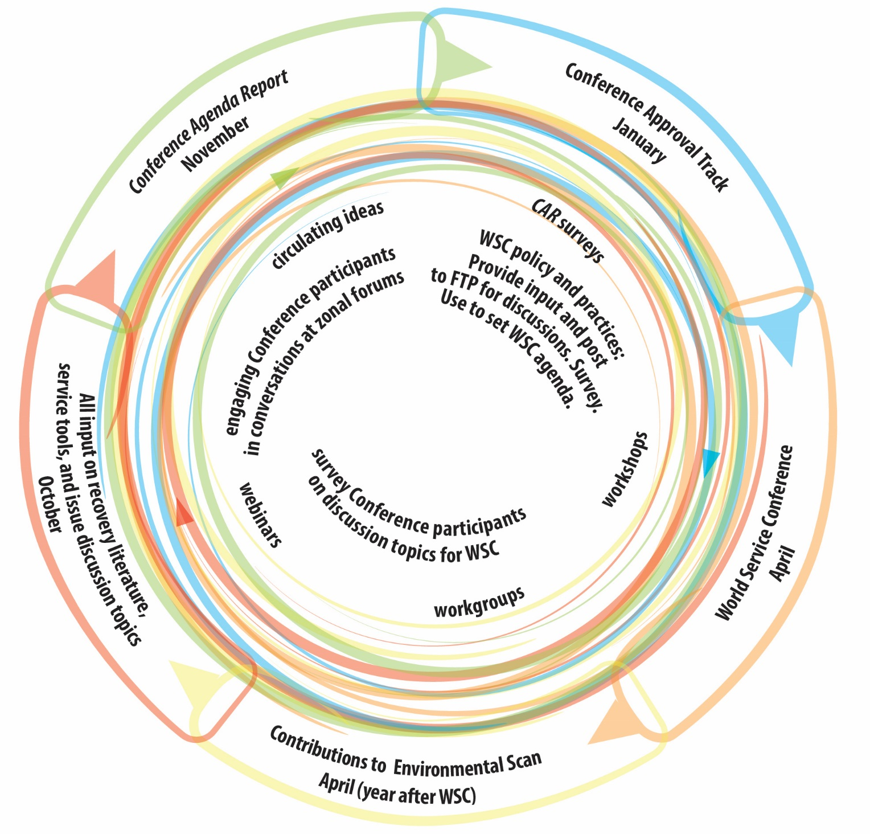
Collaborative Strategic Planning Process
Creating the strategic plan:
Environmental scan
Objectives and strategies
Project plans and budgets
Conference Approval Material
Always more work than we can achieve
Notes:
This diagram from the first Future of the WSC report represents our collaborative strategic planning process. It is an ongoing, interactive process throughout each two-year cycle with many opportunities for input from members, trusted servants, and service bodies around the world. The report can be found online here www.na.org/future.
The strategic plan starts with an environmental scan. This past cycle, for the first time, we distributed a survey asking regions to help us map the trends the plan should address. The scan data helps to determine goals for the upcoming cycle, which are the plan’s objectives. The strategies to achieve these objectives are used to create project plans, which are distributed with the Conference Approval Track material for review.
The strategic plan always contains more goals than we know we can achieve in a cycle, and usually there are more projects proposed than we expect to complete. This allows flexibility to utilize resources where and when they are available while still remaining accountable to the Fellowship.

Slide 30
2016-2018 Strategic Plan: “Develop new recovery literature and/or revise existing literature to meet Fellowship needs.”
Publish Guiding Principles: The Spirit of Our Traditions Accomplished with approval and publishing of Guiding Principles
Identify and pursue recovery literature priorities based on the results of the 2016 CAR Fellowship survey Meditation book and mental health/mental illness IP project plans will be included in 2018 Conference Approval Track Material for consideration by WSC 2018
Notes:
An example of this process is the objective included in the 2016–2018 Strategic Plan to “Develop new recovery literature and/or revise existing literature to meet Fellowship needs.” The two strategies to work toward that objective were:
To publish Guiding Principles: The Spirit of Our Traditions, and
To identify and pursue development of recovery literature priorities based on the results of the 2016 CAR Fellowship survey on recovery literature.
This first strategy was accomplished when the 2016 World Service Conference approved Guiding Principles and the book was published a few months later.
The second strategy describes a broader goal. At the 2016 WSC, delegates decided to focus on framing two projects with the highest priority in the survey—a new meditation book and an IP on recovery and mental health/mental illness. To prepare those project plans during this two-year cycle we collected thousands of pieces of input from NA members around the world about these potential pieces of literature. The input will help us frame the project plans and the focus of the pieces, and will provide some material to begin a draft. These project plans will be included in the 2018 CAT material for consideration by the 2018 WSC. If those project plans are approved, work will begin drafting the texts during the 2018-2020 cycle.

Slide 31
Environmental
Scan
internal
external
Objectives
goals
next 2 years
Strategies
approaches to accomplish goals
Project Plans
CAT
WSC decision
Notes:
In short, the strategic planning process looks like this:
We begin with the environmental scan, which helps us develop objectives for the next two years, along with strategies to work toward those objectives. From there, we develop project plans to organize the work. The project plans are included in the Conference Approval Track materials, which are reviewed and voted on by the World Service Conference.

Slide 32
Thank You!
We are grateful for thoughtful input from members and service bodies around the world to help frame the NAWS Strategic Plan.
Your participation ensures that we are working toward the goals that are most important to the Fellowship, and toward achieving A Vision for NA Service.
Notes:
We are grateful for the thoughtful input from members and service bodies around the world that helps to frame the World Services Strategic Plan. Your participation ensures that we are working toward the goals that are most important to the Fellowship, and toward achieving A Vision for NA Service.
.

Slide 33
Literature, Service Material, and Issue Discussion Topics Survey
Notes:
Let’s move on now to the CAR survey covering literature, service material, and issue discussion topics.
In 2016, we included a survey in the Conference Agenda Report to help set priorities for recovery literature, service material, and Issue Discussion Topics (or IDTs). The survey results helped the 2016 Conference select IDTs and focus the recovery literature and service material projects it approved. The 2016 survey was such an effective way to get this input from the Fellowship that we have included another survey in the 2018 CAR.

Slide 34
How was the survey developed?
Many ideas from Conference participants and from members
Regional input to our strategic planning process
Emails and calls to World Services
Workshop results
Conversations with Board members
Conference participant input on the draft of this survey
Notes:
This survey is longer than the previous one because we received so many ideas from Conference participants for what should be on the list. We also received helpful ideas through regional input to our strategic planning process, emails and calls to World Services, workshop results, conversations with Board members, and Conference participant input on an initial draft of the survey.

Slide 35
How can the survey help?
Tells us what the Fellowship believes are priorities for new recovery literature and/or service material
2016 WSC reviewed CAR survey results, and decided to frame
Two literature projects with highest priority—a new meditation book, and an IP on recovery and mental health/mental illness
Service material projects for conventions and events, and local service tools
Notes:
The CAR survey is a way for the Fellowship to tell us what it believes are priorities for new recovery literature and/or service material. Items that gain traction—like a new meditation book and an IP on mental health/mental illness in 2016—may get WSC approval for the next steps. This might involve collecting front-end input through surveys or web meetings to shape a project plan for consideration at WSC 2020.

Slide 36
Recovery Literature Survey
Unless otherwise directed by WSC 2018, we plan to prioritize work on focuses agreed upon by WSC 2016:
A meditation book
An IP on mental health/mental illness
These survey results will help prioritize possible future work/project plans.
Please choose at least one, but no more than two from the list
This survey begins on page 32 of the 2018 CAR and is available to complete online at www.na.org/conference
Notes:
Unless otherwise directed by WSC 2018, during the upcoming cycle we plan to prioritize work on the focuses agreed upon by WSC 2016: a meditation book and an IP on mental health/mental illness. The results of the 2018 CAR survey will help prioritize possible future work and project plans.
Please choose at least one, but no more than two from the list. The Recovery Literature Survey begins on page 32 of the 2018 CAR and is also available at www.na.org/conference.

Slide 37
Recovery Literature Survey
Literature targeted to: Younger members
Literature targeted to: Older members
Literature targeted to: Experienced members/“oldtimers”
Literature targeted to: LGBTQ members
Literature targeted to: Women in recovery
Literature targeted to: First nations/indigenous members
Literature targeted to: Members who are professionals
Literature targeted to: Members who are veterans
Literature targeted to: Atheists and members with non-mainstream spiritual beliefs
An IP: Regardless of age, race, sex, sexual identity, creed, religion, or lack of religion
What does it mean that NA is a spiritual, not religious, program?
Revise the Sponsorship book
Revise The Loner
Revise H&I Service and the NA Member
Revise PI and the NA Member
Revise another piece of NA literature:
Other:
No new recovery lit
Adapt Social Media and Our Guiding Principles to an IP from an SP
An IP for members: NA and addicts on DRT/MAT
Booklet of Step study questions taken from “How It Works” in the Basic Text
Booklet of Step study questions from It Works: How and Why and/or Living Clean
Step working booklet focused mainly on Steps 1–3 aimed primarily for new members and those in treatment and drug courts
Step working guide aimed at members not new to the Steps, as a follow-up set of Steps
Concepts book similar to Guiding Principles
List and definition of spiritual principles
The spiritual benefits of service
Members’ experience, strength, and hope on trustworthiness and trusting
Atmosphere of recovery in service
Appropriate meeting behavior
Pamphlet on the First Tradition
Notes:
This is the full list of items in the recovery literature section of the survey. Again, we encourage you to share your ideas.
Recovery Literature Survey
Adapt Social Media and Our Guiding Principles to an IP from an SP
An IP for members: NA and addicts on DRT/MAT
Booklet of Step study questions taken from “How It Works” in the Basic Text
Booklet of Step study questions from It Works: How and Why and/or Living Clean
Step working booklet focused mainly on Steps 1–3 aimed primarily for new members and those in treatment and drug courts
Step working guide aimed at members not new to the Steps, as a follow-up set of Steps
Concepts book similar to Guiding Principles
List and definition of spiritual principles
The spiritual benefits of service
Members’ experience, strength, and hope on trustworthiness and trusting
Atmosphere of recovery in service
Appropriate meeting behavior
Pamphlet on the First Tradition
Literature targeted to: Younger members
Literature targeted to: Older members
Literature targeted to: Experienced members/“oldtimers”
Literature targeted to: LGBTQ members
Literature targeted to: Women in recovery
Literature targeted to: First nations/indigenous members
Literature targeted to: Members who are professionals
Literature targeted to: Members who are veterans
Literature targeted to: Atheists and members with non-mainstream spiritual beliefs
An IP: Regardless of age, race, sex, sexual identity, creed, religion, or lack of religion
What does it mean that NA is a spiritual, not religious, program?
Revise the Sponsorship book
Revise The Loner
Revise H&I Service and the NA Member
Revise PI and the NA Member
Revise another piece of NA literature:
Other:
No new recovery lit

Slide 38
Service Material Survey
Work is currently underway on two service material project focuses agreed upon by WSC 2016:
Local Service Toolbox
Conventions and Events Toolbox
These survey results will help prioritize possible future work/project plans. Most of the items in this survey could easily fit into a Local Service Toolbox.
Please choose at least one, but no more than two from the list
This survey begins on page 33 of the 2018 CAR and is available to complete online at www.na.org/conference
Notes:
Work is currently underway on two service material project focuses agreed upon by WSC 2016:
Local Service Toolbox
Conventions and Events Toolbox
The results of the current survey will help prioritize possible future work or project plans. Most of the items in this survey could easily fit into a Local Service Toolbox along with the two pieces already in development.
Please choose at least one, but no more than two from the list. This survey begins on page 33 of the 2018 CAR and is available to complete online at www.na.org/conference.

Slide 39
Service Material Survey
Regional inventory process/questions
Description of service commitments at areas and regions [Note: We already have a service pamphlet on group trusted servants. If this piece is prioritized, it might make sense to somehow combine this information.]
Effective report writing
GSR orientation material
Literature on mentorship, including as it relates to service bodies and new meetings
Service system basics
Local service conference and local service board basics
Role of zones in the service structure
Policy in NA—different kinds of policy styles and approaches
Information for creating legal entities/incorporating
The Fellowship Intellectual Property Trust (FIPT) and local websites
Dealing with banks and government financial regulations
Dealing with misappropriation of NA funds
Area treasurers’ basics
Area budgeting basics
Revise Translation Basics
Revise and update PR Handbook
Other:
Carrying the NA message
Principles in service
Atmosphere of recovery in service
Applying the Concepts—videos of members sharing in their own words how they applied each Concept
What is NA World Services and how does it work?
Our public image: dealing with loss of confidence in NA
More social media guidelines above and beyond the service pamphlet
More short, focused PR resources
Tools to assist PR efforts to reach the medical community
Literature for justice department professionals/referrers
Sponsorship behind the walls basics
Fellowship development basics
FD—it’s not just something that happens “somewhere else”
Collaborating among service bodies
When service bodies split or reunify
How to hold a virtual service meeting
Facilitation basics
How to plan a learning day
Best practices for service workshops
How to put on a planning assembly (including sample agendas)
Getting started with project-based services
Revise Planning Basics
Notes:
This is the full list of items in the service material section of the survey. We look forward to seeing your thoughts.
Service Material Survey
Carrying the NA message
Principles in service
Atmosphere of recovery in service
Applying the Concepts—videos of members sharing in their own words how they
applied each Concept
What is NA World Services and how does it work?
Our public image: dealing with loss of confidence in NA
More social media guidelines above and beyond the service pamphlet
More short, focused PR resources
Tools to assist PR efforts to reach the medical community
Literature for justice department professionals/referrers
Sponsorship behind the walls basics
Fellowship development basics
FD—it’s not just something that happens “somewhere else”
Collaborating among service bodies
When service bodies split or reunify
How to hold a virtual service meeting
Facilitation basics
How to plan a learning day
Best practices for service workshops
How to put on a planning assembly (including sample agendas)
Getting started with project-based services
Revise Planning Basics
Regional inventory process/questions
Description of service commitments at areas and regions [Note: We already have a service pamphlet on group trusted servants. If this piece is prioritized, it might make sense to somehow combine this information.]
Effective report writing
GSR orientation material
Literature on mentorship, including as it relates to service bodies and new meetings
Service system basics
Local service conference and local service board basics
Role of zones in the service structure
Policy in NA—different kinds of policy styles and approaches
Information for creating legal entities/incorporating
The Fellowship Intellectual Property Trust (FIPT) and local websites
Dealing with banks and government financial regulations
Dealing with misappropriation of NA funds
Area treasurers’ basics
Area budgeting basics
Revise Translation Basics
Revise and update PR Handbook
Other:

Slide 40
Issue Discussion Topics Survey
Issues that are discussed throughout the Fellowship for two years between World Service Conferences
Results of your IDT workshops and discussions can help create the foundation for service pamphlets and other tools and literature
These survey results will help decide the 2018-2020 IDTs
Please choose at least one, but no more than two from the list
This survey begins on page 34 of the 2018 CAR and is available to complete online at www.na.org/conference.
Notes:
Issue Discussion Topics are subjects of interest to the NA Fellowship that are discussed throughout the Fellowship for the two years between Conferences. The results of IDT workshops and discussions can help to create the foundation for service pamphlets and other tools and literature. These survey results will help delegates decide on the Issue Discussion Topics for the 2018-2020.
Please choose at least one, but no more than two from the list. This survey begins on page 34 of the 2018 CAR and is available to complete online at www.na.org/conference.

Slide 41
IDTs Survey
Our Symbol—a closer look
Group conscience
Carrying the NA message and making NA attractive
Remaining nonprofessional and carrying the NA message
PR 101
Simplicity and flexibility in service
Empathy in service
Attracting members to service
Getting youth and newcomers involved
Becoming a better sponsor
Creating community in NA
Mentorship and how members learn in service
Leadership in NA
The integrity and effectiveness of our communications
Eleventh Concept
Respecting our differences and building our unity
Regardless of . . . race, ethnicity, culture
Retaining members
In Times of Illness and what our literature says about illness and medication
Other:
Notes:
This is the full list of topics in the final section of the 2018 CAR survey. We look forward to seeing your priorities for discussions in the upcoming cycle.
IDTs Survey:
Our Symbol—a closer look
Group conscience
Carrying the NA message and making NA attractive
Remaining nonprofessional and carrying the NA message
PR 101
Simplicity and flexibility in service
Empathy in service
Attracting members to service
Getting youth and newcomers involved
Becoming a better sponsor
Creating community in NA
Mentorship and how members learn in service
Leadership in NA
The integrity and effectiveness of our communications
Eleventh Concept
Respecting our differences and building our unity
Regardless of . . . race, ethnicity, culture
Retaining members
In Times of Illness and what our literature says about illness and medication
Other:

Slide 42
All the original PowerPoints available online
Surveys available online
CAR can be downloaded or hard copies ordered from NA World Services
www.na.org/conference
worldboard@na.org
Notes:
We hope this video has helped in your discussion of this material. Please note that there are four other videos that focus on other CAR contents. These videos, the Conference Agenda Report, and the CAR survey are available online at www.na.org/conference. Hard copies of the CAR may be purchased from NA World Services.
We welcome your questions and your feedback on these videos, the CAR, and all other issues at worldboard@na.org.

